Slide 10
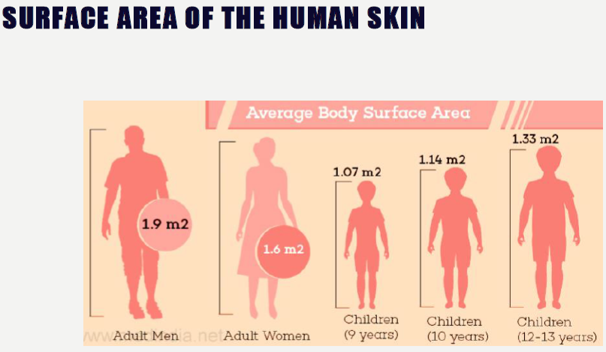

Slide 13
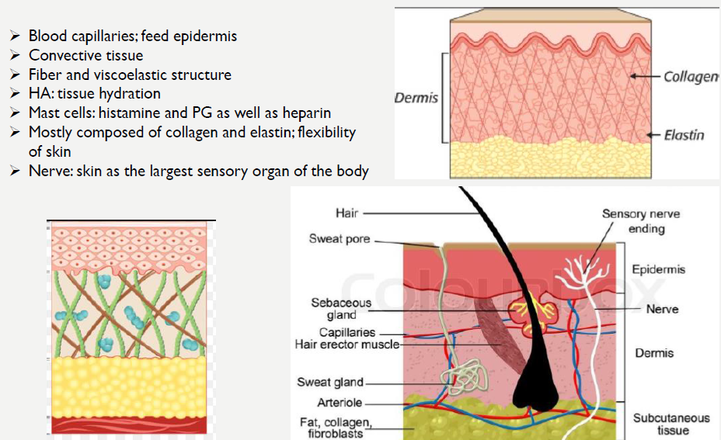

Slide 16
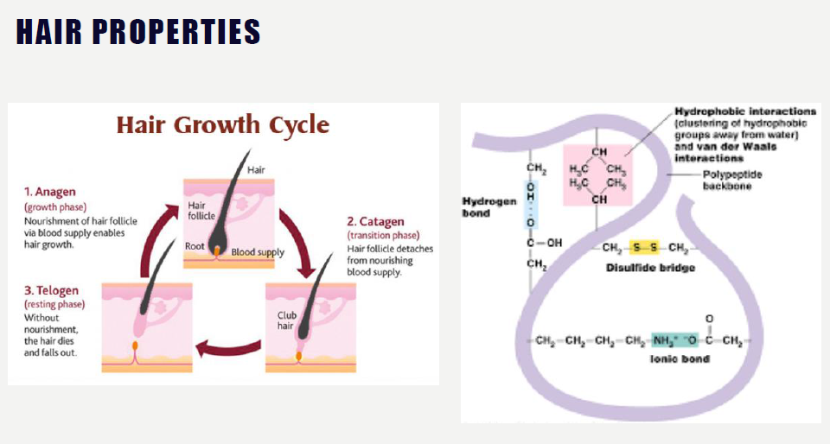

Slide 22
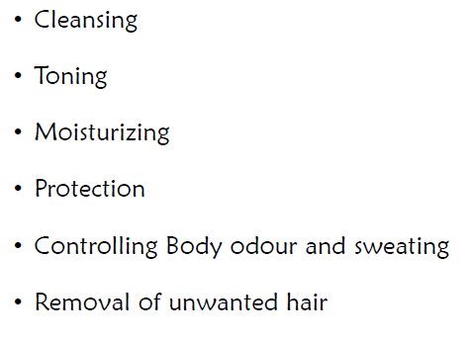

Slide 23
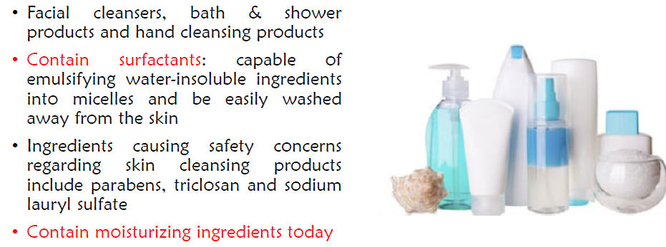

Slide 25
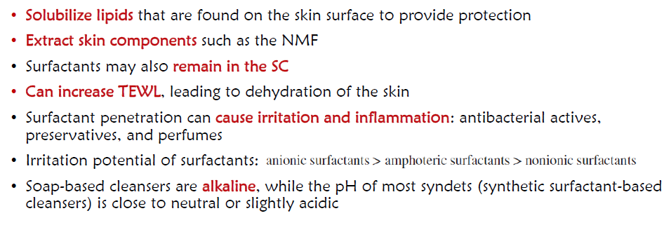

Slide 26
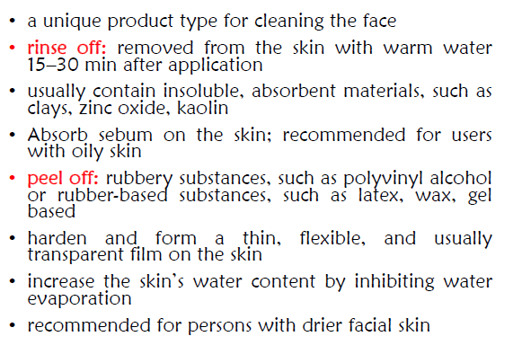
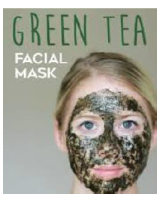

Slide 44
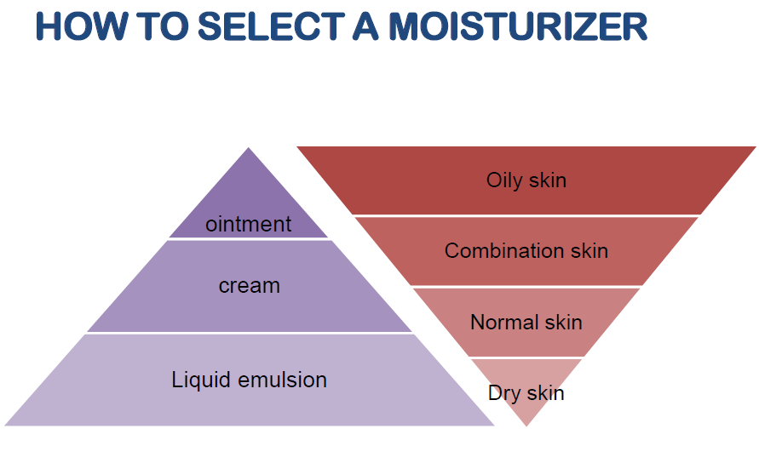

Slide 51
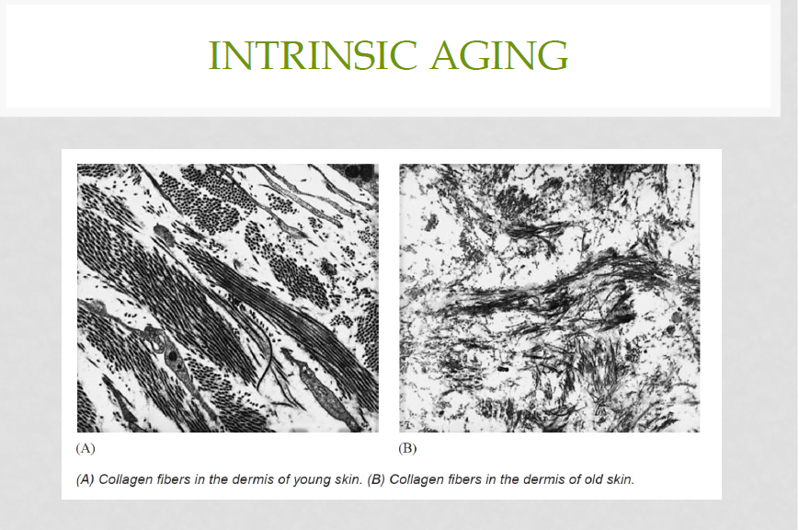

Slide 52
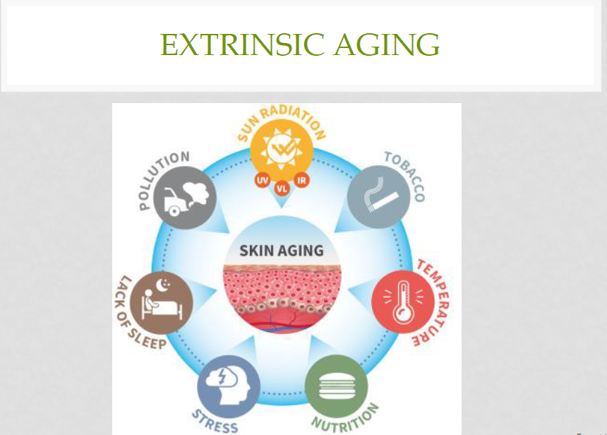

Slide 61
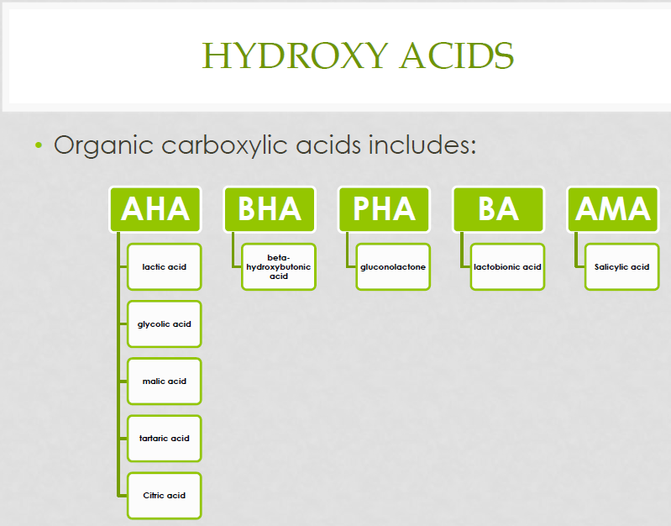

Slide 70
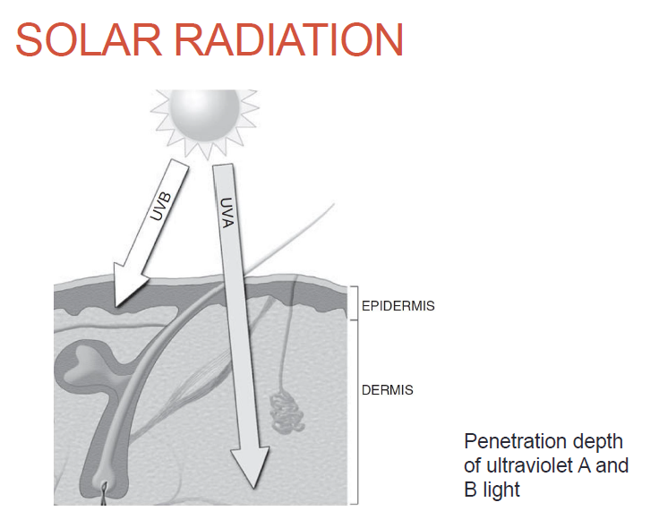

Slide 74
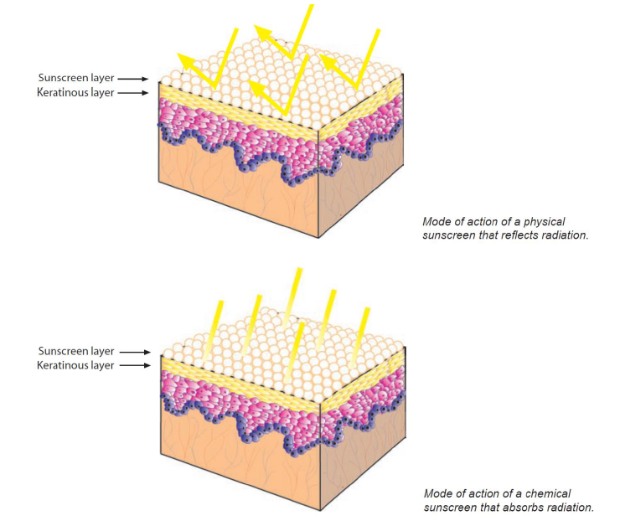

Slide 76
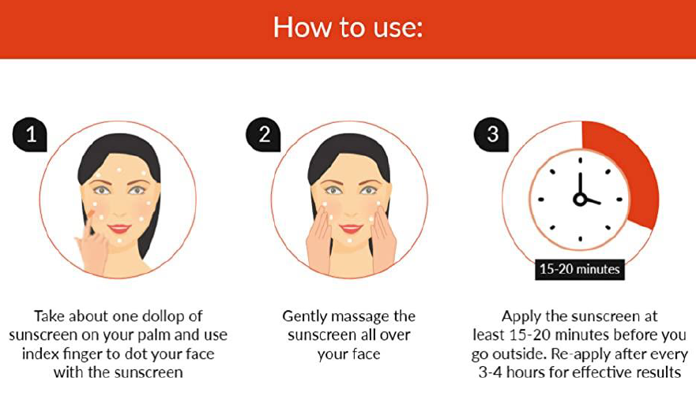

Slide 79
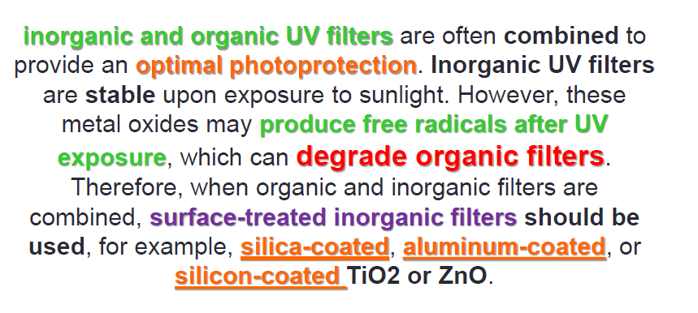

Slide 83
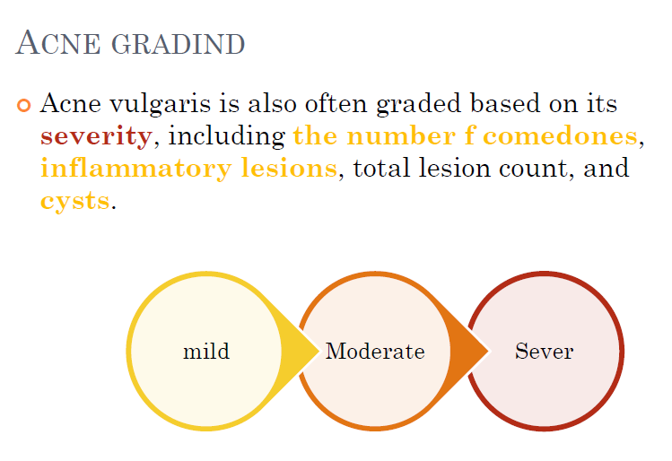

Slide 95
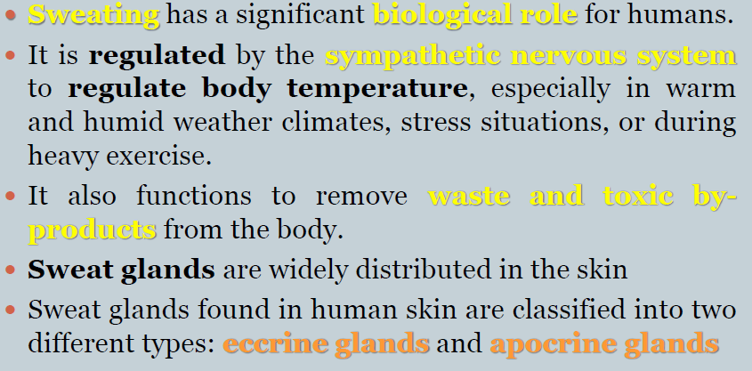

Slide 96
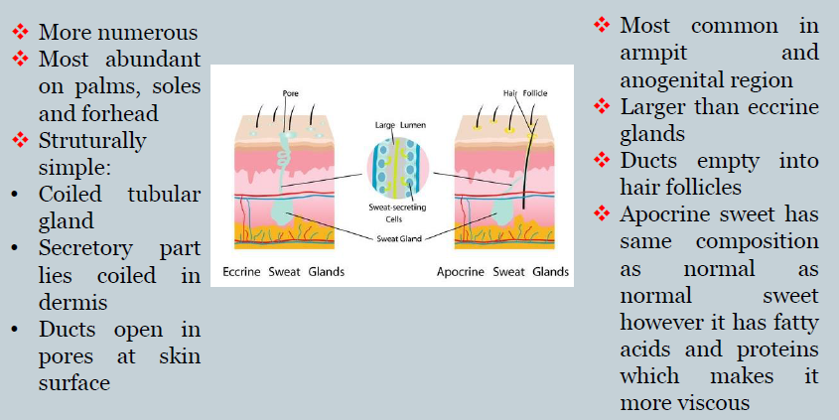

Slide 97
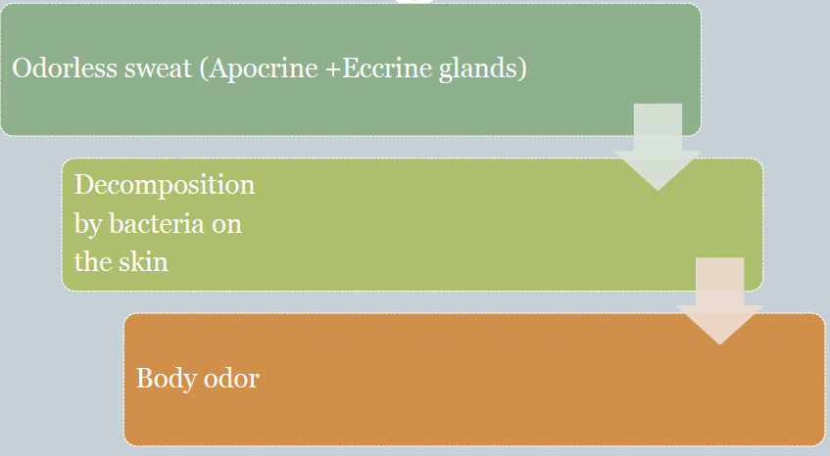

Slide 119
Advances of Nanocarrier Technology-Based Active Cosmetic Ingredients for Beauty Applications
Can effectively promote the percutaneous penetration
Improve the water dispersion of insoluble active cosmetic ingredients
Enhance the stability of components
Achieve the co-delivery of diverse cosmetics active ingredients

Slide 120
List of Nanocarriers Applied in Functional Cosmetic Products

Slide 121
List of Nanocarriers Applied in Functional Cosmetic Products

Slide 122
List of Nanocarriers Applied in Functional Cosmetic Products

Slide 123
List of Nanocarriers Applied in Functional Cosmetic Products

Slide 124
Biocosmetics: technological advances and future outlook
100% natural ingredients derived from plants, animals, microbes, enzymes, insects, and organic crops
Used for topical skin, hair, face, and oral care
Petroleum or mineral oil-derived ingredients, harmful and non-biodegradable
From fossil-based ingredients to bio-based ingredients
A typical cosmetic contains about 15–20 ingredients and considering, the use of at least five cosmetic products per day; we are placing 75–100 chemicals on our skin through cosmetic use
Potentially toxic compounds: lead, aluminum, mercury, parabens

Slide 125
Example:
Benzophenone: component of sunscreen, carcinogenic to humans, good lipophilic properties, this substance absorbed in high concentrations and can be detected in biological fluids including mother’s milk

Slide 126
Example:
Toluene and dibutyl phthalate: in several cosmetic products and nail polish; both dermal and inhalation routes and cause reproductive toxicity and damage to the nervous system

Slide 128
Biotechnological ingredients: safe and effective
kojic acid
Hyaluronic acid
Resveratrol
Human epidermal growth factors
Superoxide dismutase
Photolyases Organic acids: citric acid, lactic acid, glycolic acid
Microalgae source of fatty acids, lipids, proteins, amino acids, and algal extract as an antioxidant, and anti-aging agent
Stem cells to regenerate old damaged cells

Slide 129
Bioactive ingredients isolated from marine organisms and their use in cosmetic products

Slide 130
Personalized cosmetic with 3D bio-printing
tissue-like structures built in record time to mimic the natural tissues of our body
enables the production of the patient’s cells, which are perfectly compatible during skin grafting or even during organ replacement
Bioinks used in bioprinters biocompatible materials such as polysaccharides, protein, synthetic polymers
personalized treatment depigmented surface for treating vitiligo with growth factors, stem cells, and cytokines

Slide 131
Zero waste cosmetic
Stop cosmetic waste from entering the human body through a polluted environment.
Implementing zero waste and zero CO2 emission policies in the sourcing, extraction, production, and packaging processes of cosmetics will push the idea of “Green Growth.”
The environmental impact of conventional cosmetics made of microbeads, microplastic, and triclosan is huge and calls for serious attention.
BHA and BHT, synthetic antioxidants used as cosmetic preservatives, enter aquatic species and cause genetic alteration.

Slide 132
Beauty and personal care: post‑COVID‑19 outbreak
cosmetics industry affected due to the disrupted supply of raw materials, production processes, marketing, and distribution of finished products
cosmetic products are directed to interact with human virome to maintain good skin health
the growing consumer trend is toward natural ingredients to boost skin immunity and hence the beauty industry must leverage the products with anti-inflammatory and skin immune boosting ingredients
marketing to the post-COVID consumer by focusing on health-related product development

